Slide 2
Using .NET to build the .NET website
Jon Galloway & Maira Wenzel
Microsoft

Slide 3

.NET website architecture and DevOps

Slide 4
dotnet.microsoft.com
Main goals
- Downloads
- Entry point for new developers and decision makers
- Marketing
Technologies used
- ASP.NET Core Razor Pages
- Blazor
- React Components (legacy)
- Azure Functions
Azure App Services
Premium V2 Pricing Tier (P2v2) – 2 cores
Team
1 PM
2 devs
1 Analytics/SEO

Slide 5
Monthly metrics
18.3M
5M
Page views
Unique visitors/months
* Last 6 months average
Notes:
High up-time, few incidents

Slide 6
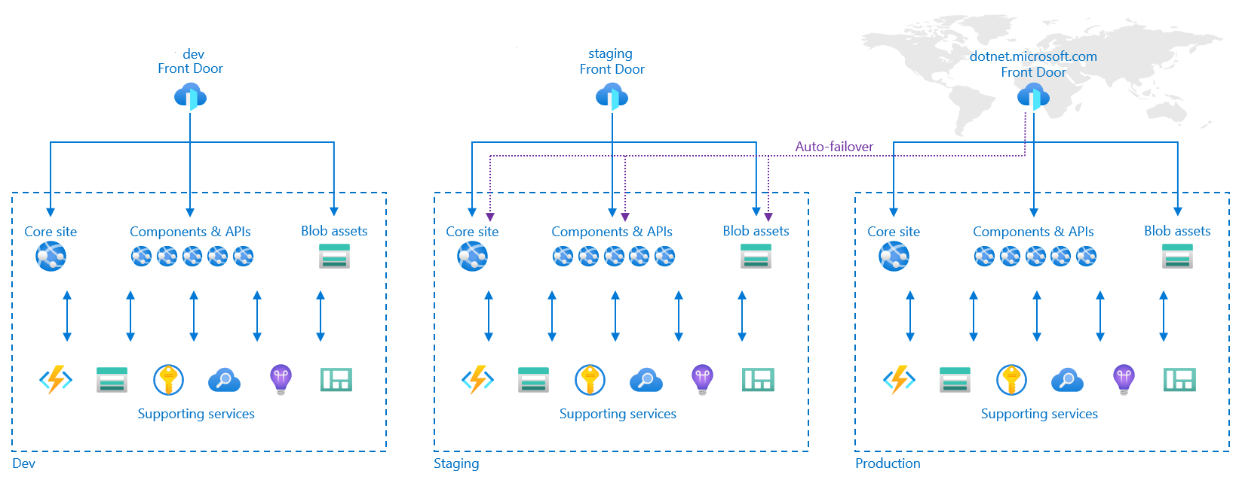
Architecture

Slide 7
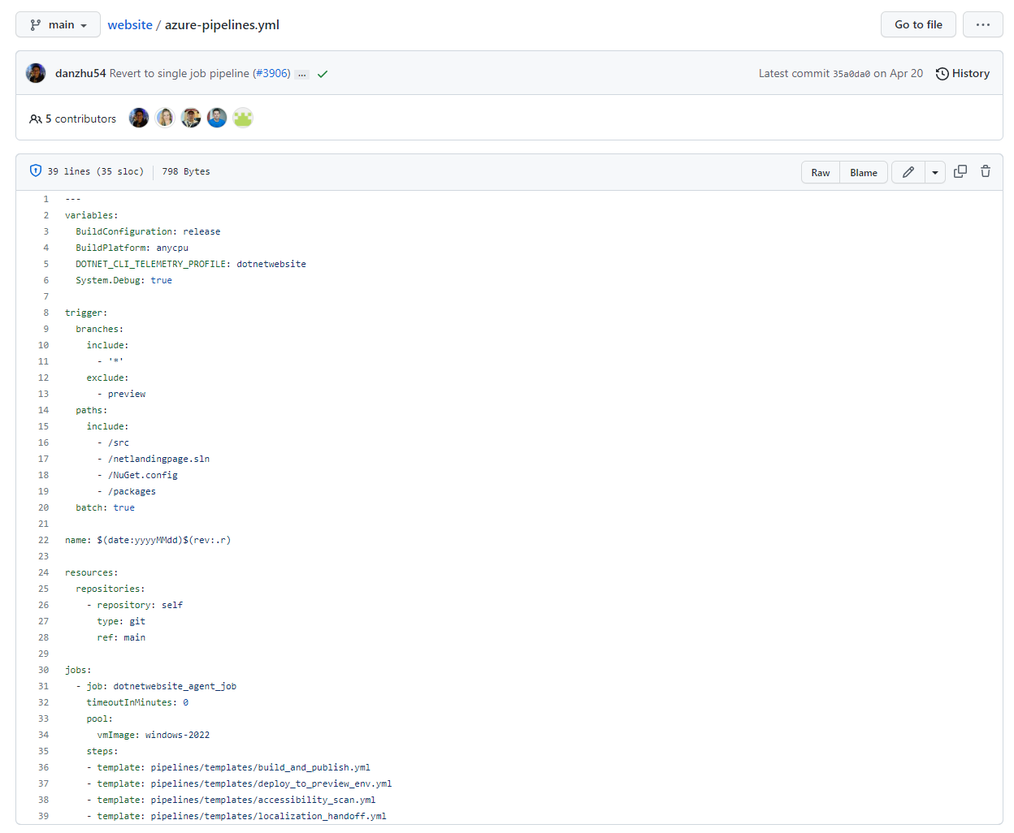
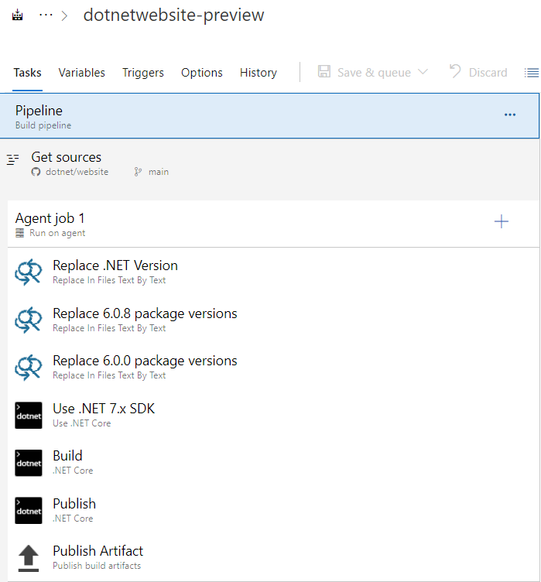
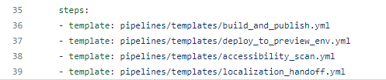
Pipelines
Main pipeline
Preview version pipeline
Notes:
We’ve converted most of the pipelines to YAML format except for the preview version pipeline

Slide 8
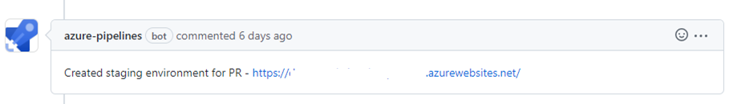
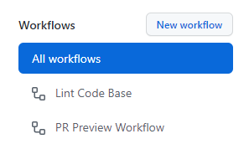
Preview Pull requests site
Each pull request deploys the site in one of the slots of the dev env
Pipelines bot publishes the site for review
Makes the review process much easier since the team doesn’t have to download the branch locally every time
GitHub Action excludes the deployment slot after the pull request is merged or closed

Slide 9
Azure App Insights
Notes:
500: https://github.com/dotnet/website/pull/1911

Slide 10
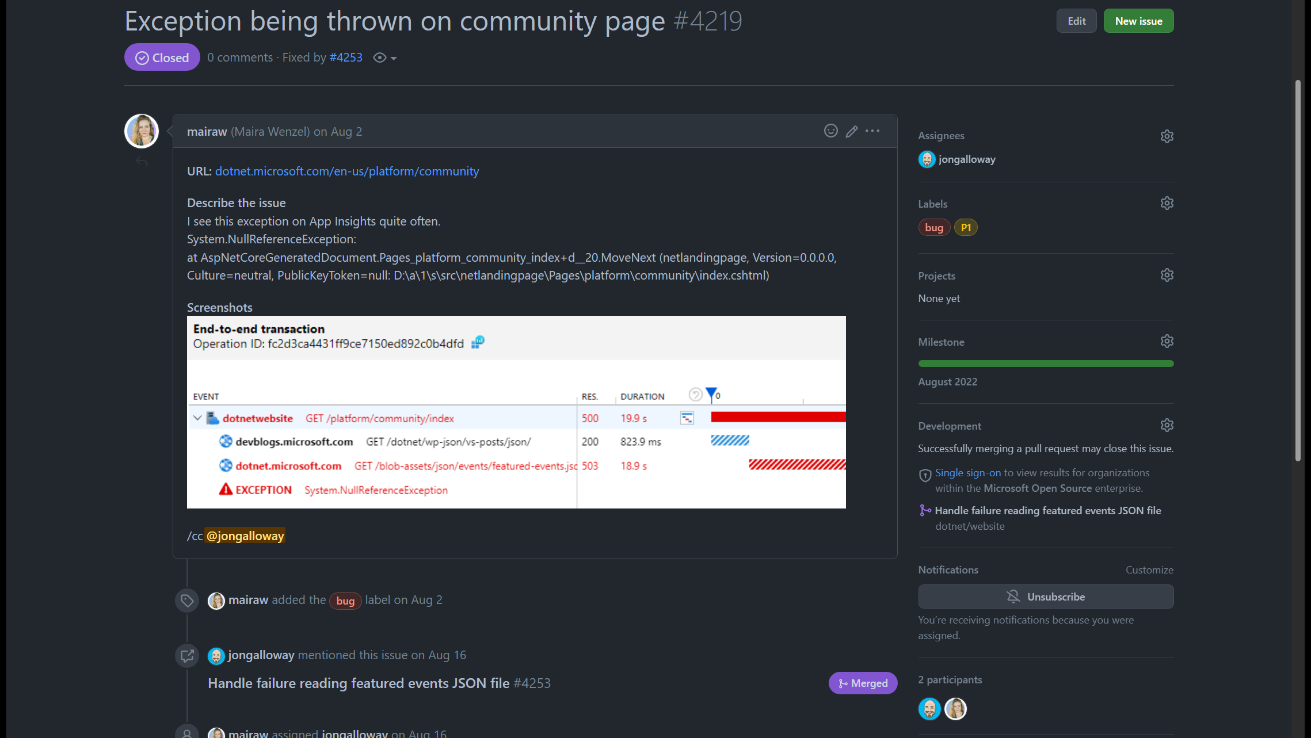
Notes:
500: https://github.com/dotnet/website/pull/1911
Jon show a fixed issue – stack trace

Slide 11
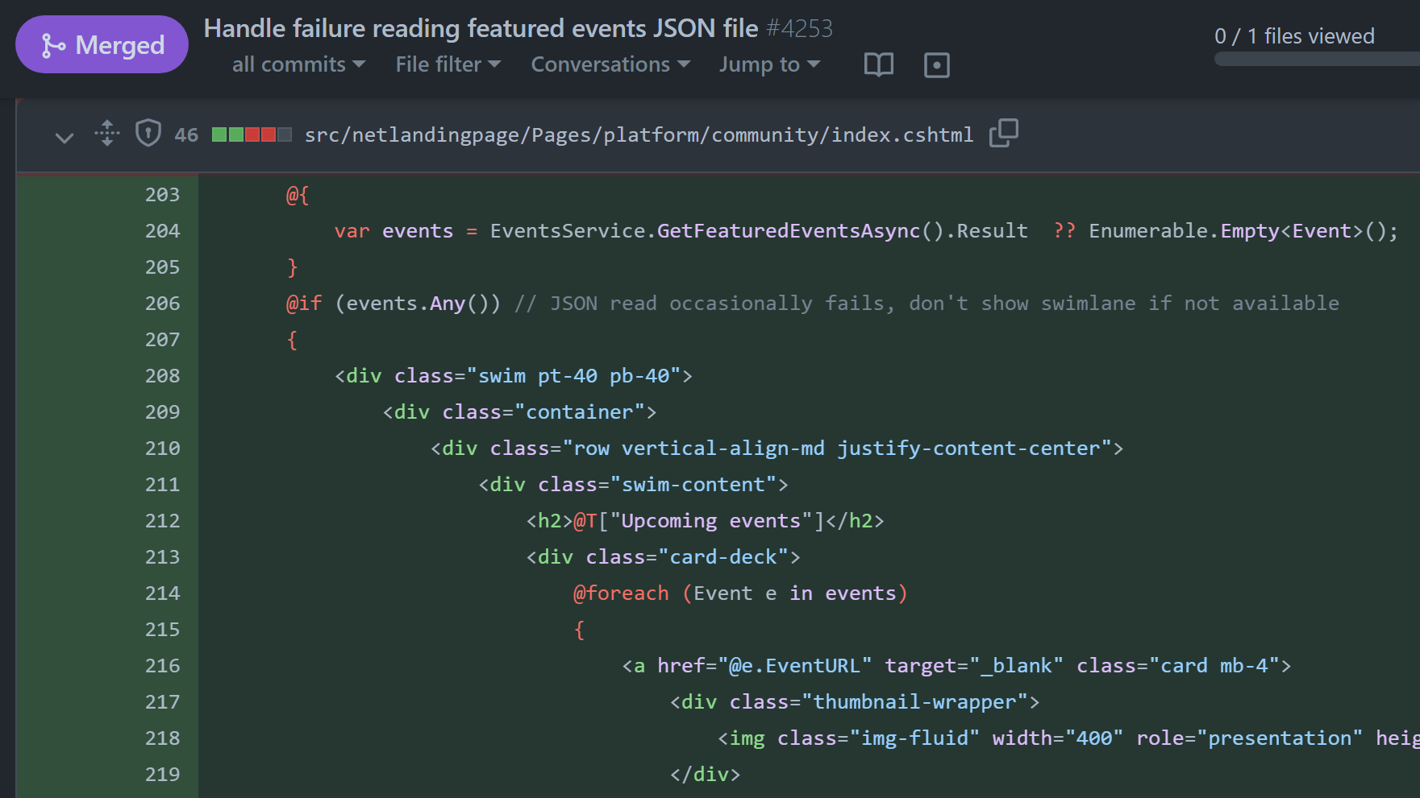

Slide 12
Exploring some .NET website additions

Slide 13
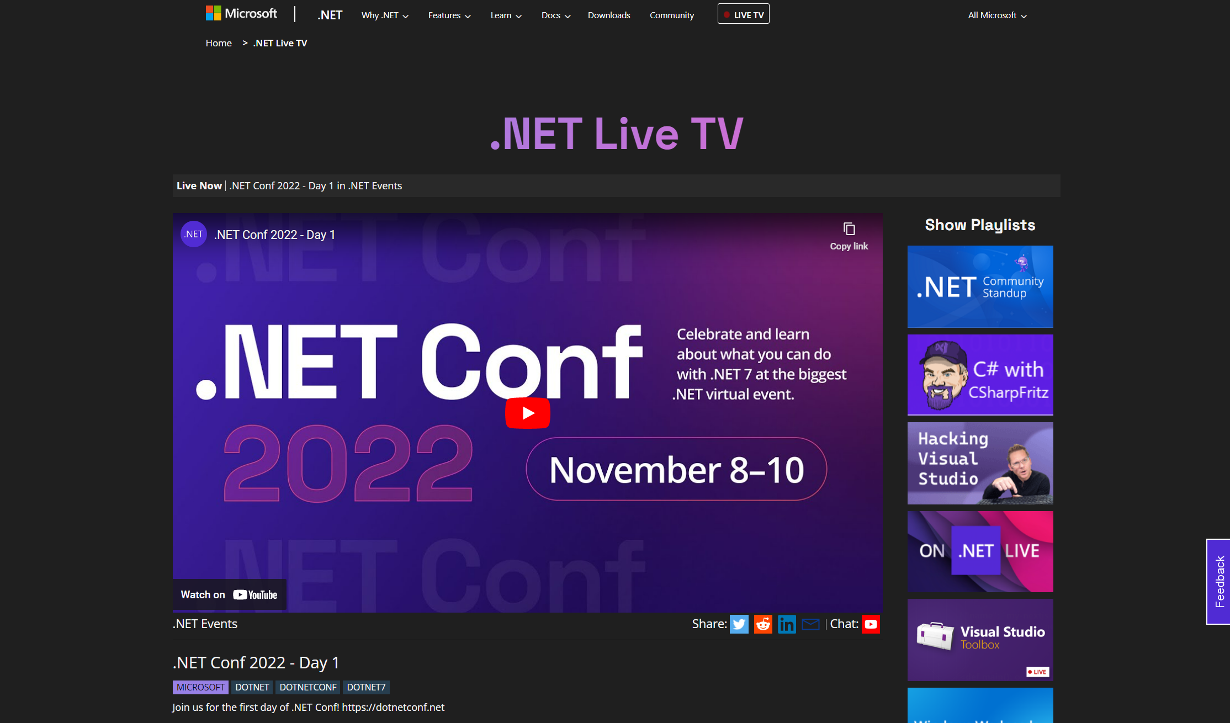
Notes:
Blazor front end
Azure Function

Slide 14
.NET Live TV Requirements
Normalized schedule API from YouTube & Blob Storage
Show upcoming & completed shows
Live Show View
Easily scale to add more shows
Get all live & on demand metrics for shows
Generate reports for hosts & bosses

Slide 15







.NET Live TV Architecture
Schedule Updater
Website
{JSON}
Notes:
Jon – the first part is to create a backend for the website that automatically updates a schedule. Looks at multiple YouTube playlist as the source of truth which updates if it is schedule, live, or finished, but also we read from multiple json files for shows and events that don’t have playlists or aren’t on YouTube. Also, this enables us to limit our YouTube API usage.
Once this was live, we could create a web app that would pull this data and display it. Instead of creating another backend, we already had all of the logic to read/write from the azure search from the schedule updater so we created a serverless backend for the website.

Slide 16
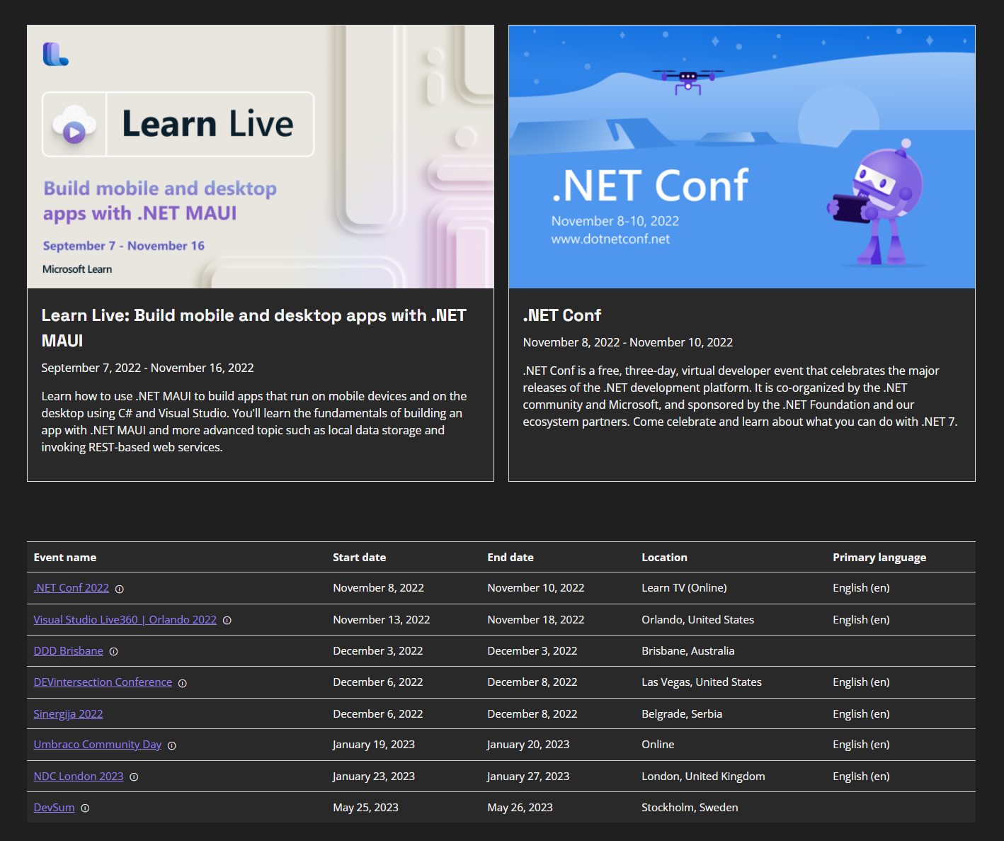
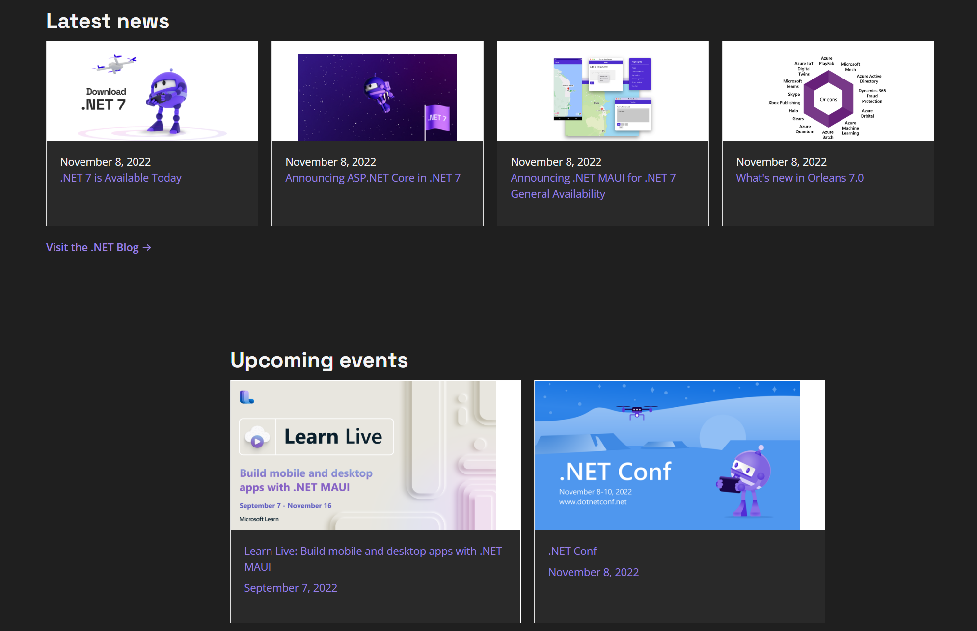
Community page features

Slide 17
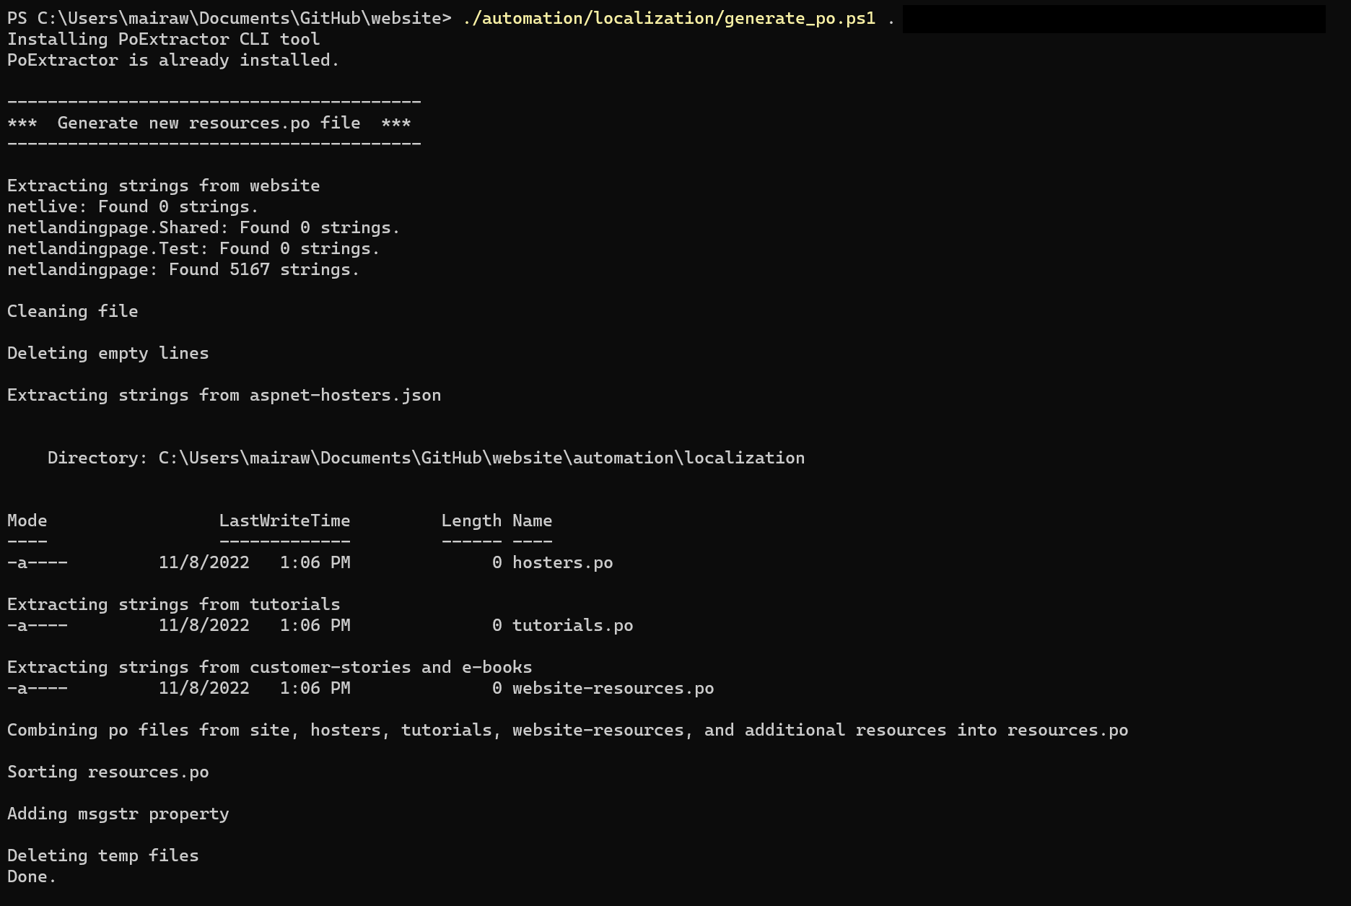
Website localization
Uses Portable Object (PO) files with Orchard Core
PO files are distributed as text files containing the translated strings for a given language.
Usually pair of ID and translation:
Uses POExtractor tool to extract translatable strings
msgid "Free. Cross-platform. Open source."
msgstr ""
msgid "Free. Cross-platform. Open source."
msgstr "無料。クロスプラットフォーム。オープン ソース。"
Notes:
Advantages of PO files over .resx files: Support pluralization.
Aren't compiled so specialized tooling and build steps aren't required.
Work well with collaborative online editing tools.
Easy to read/parse.
Open-source projects can leverage crowdin

Slide 18
Website localization process
Reference the Orchard Core NuGet package
Changes to the middleware and routing logic
We use Accept headers to redirect to a locale if URL is missing the locale
<PackageReference Include="OrchardCore.Localization.Core" Version="1.4.0" />

Slide 19
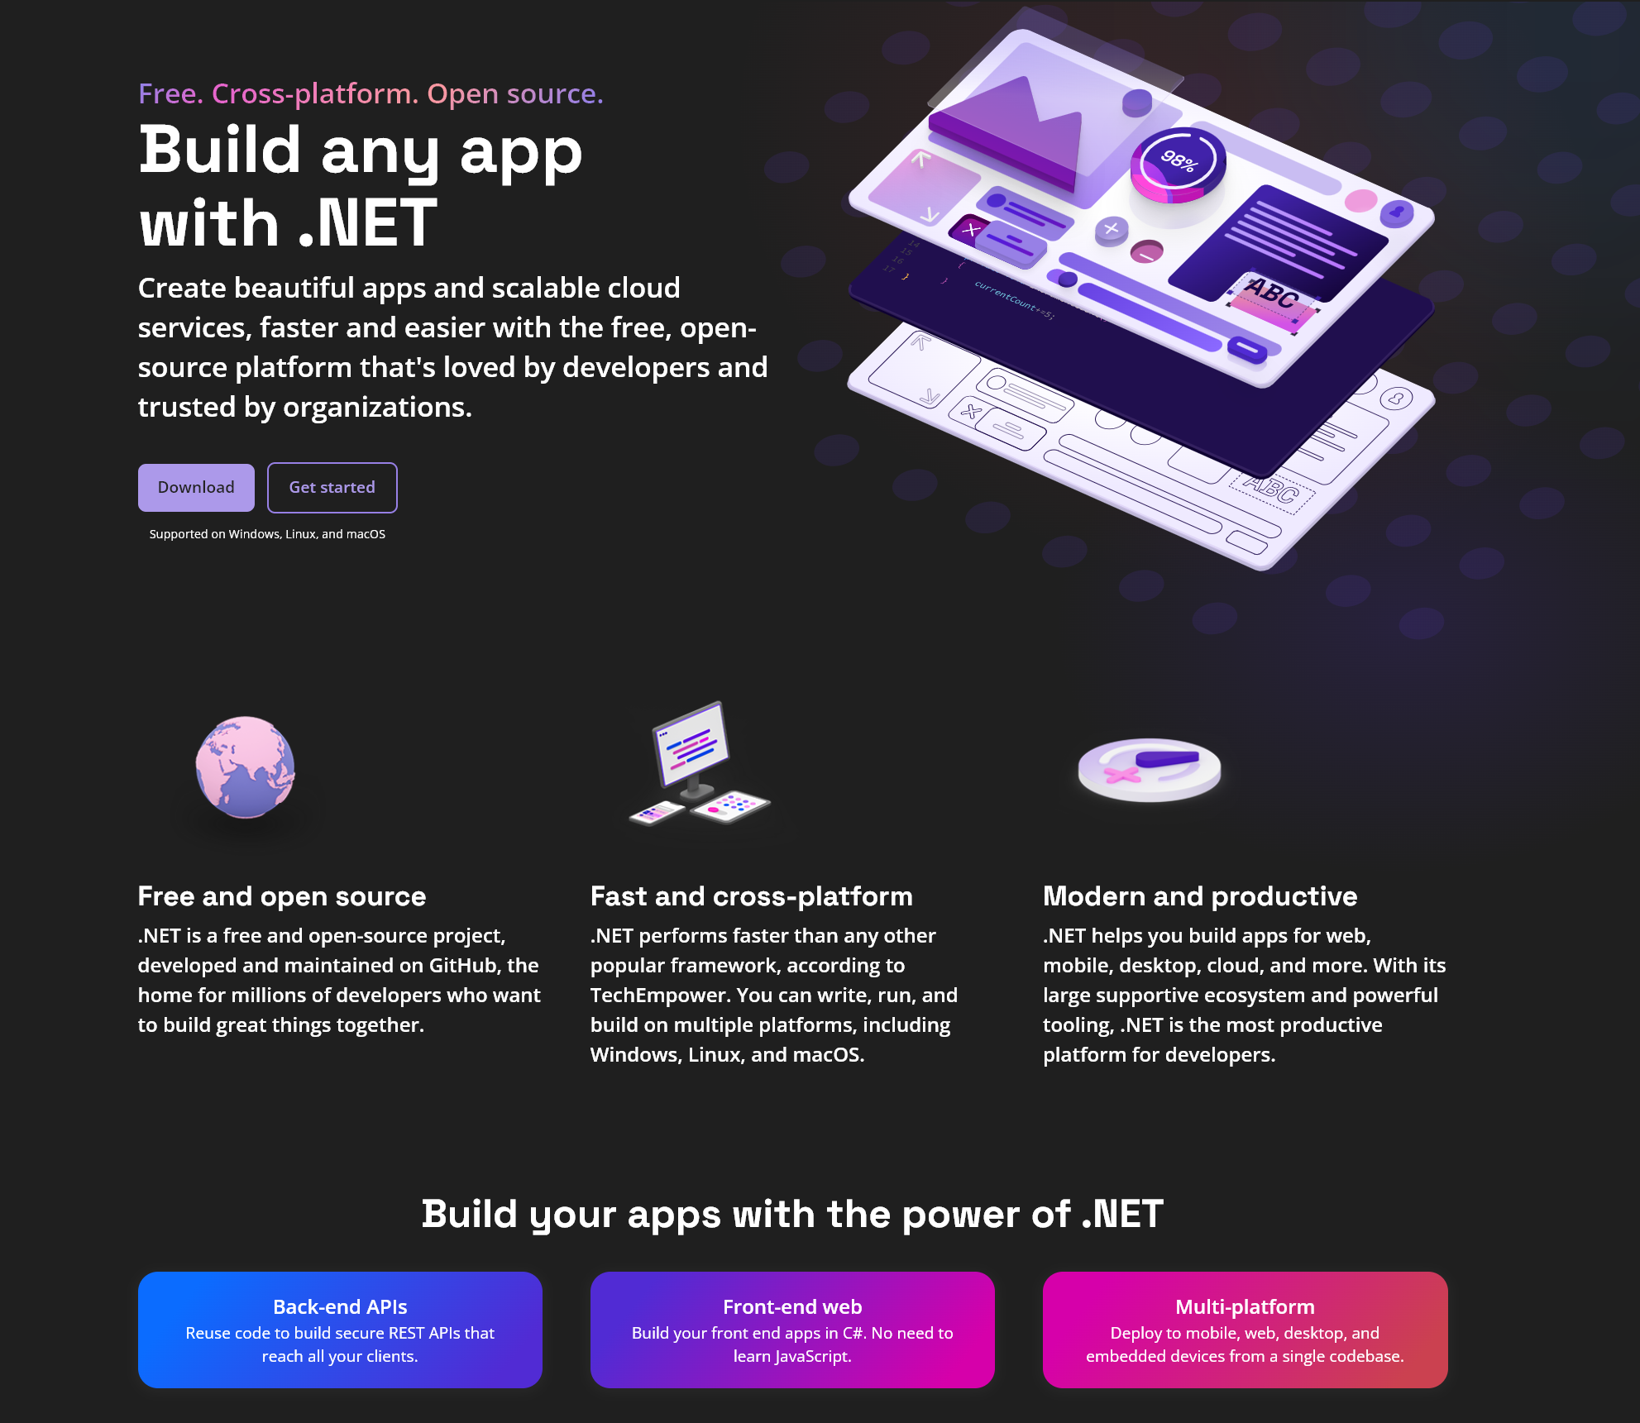
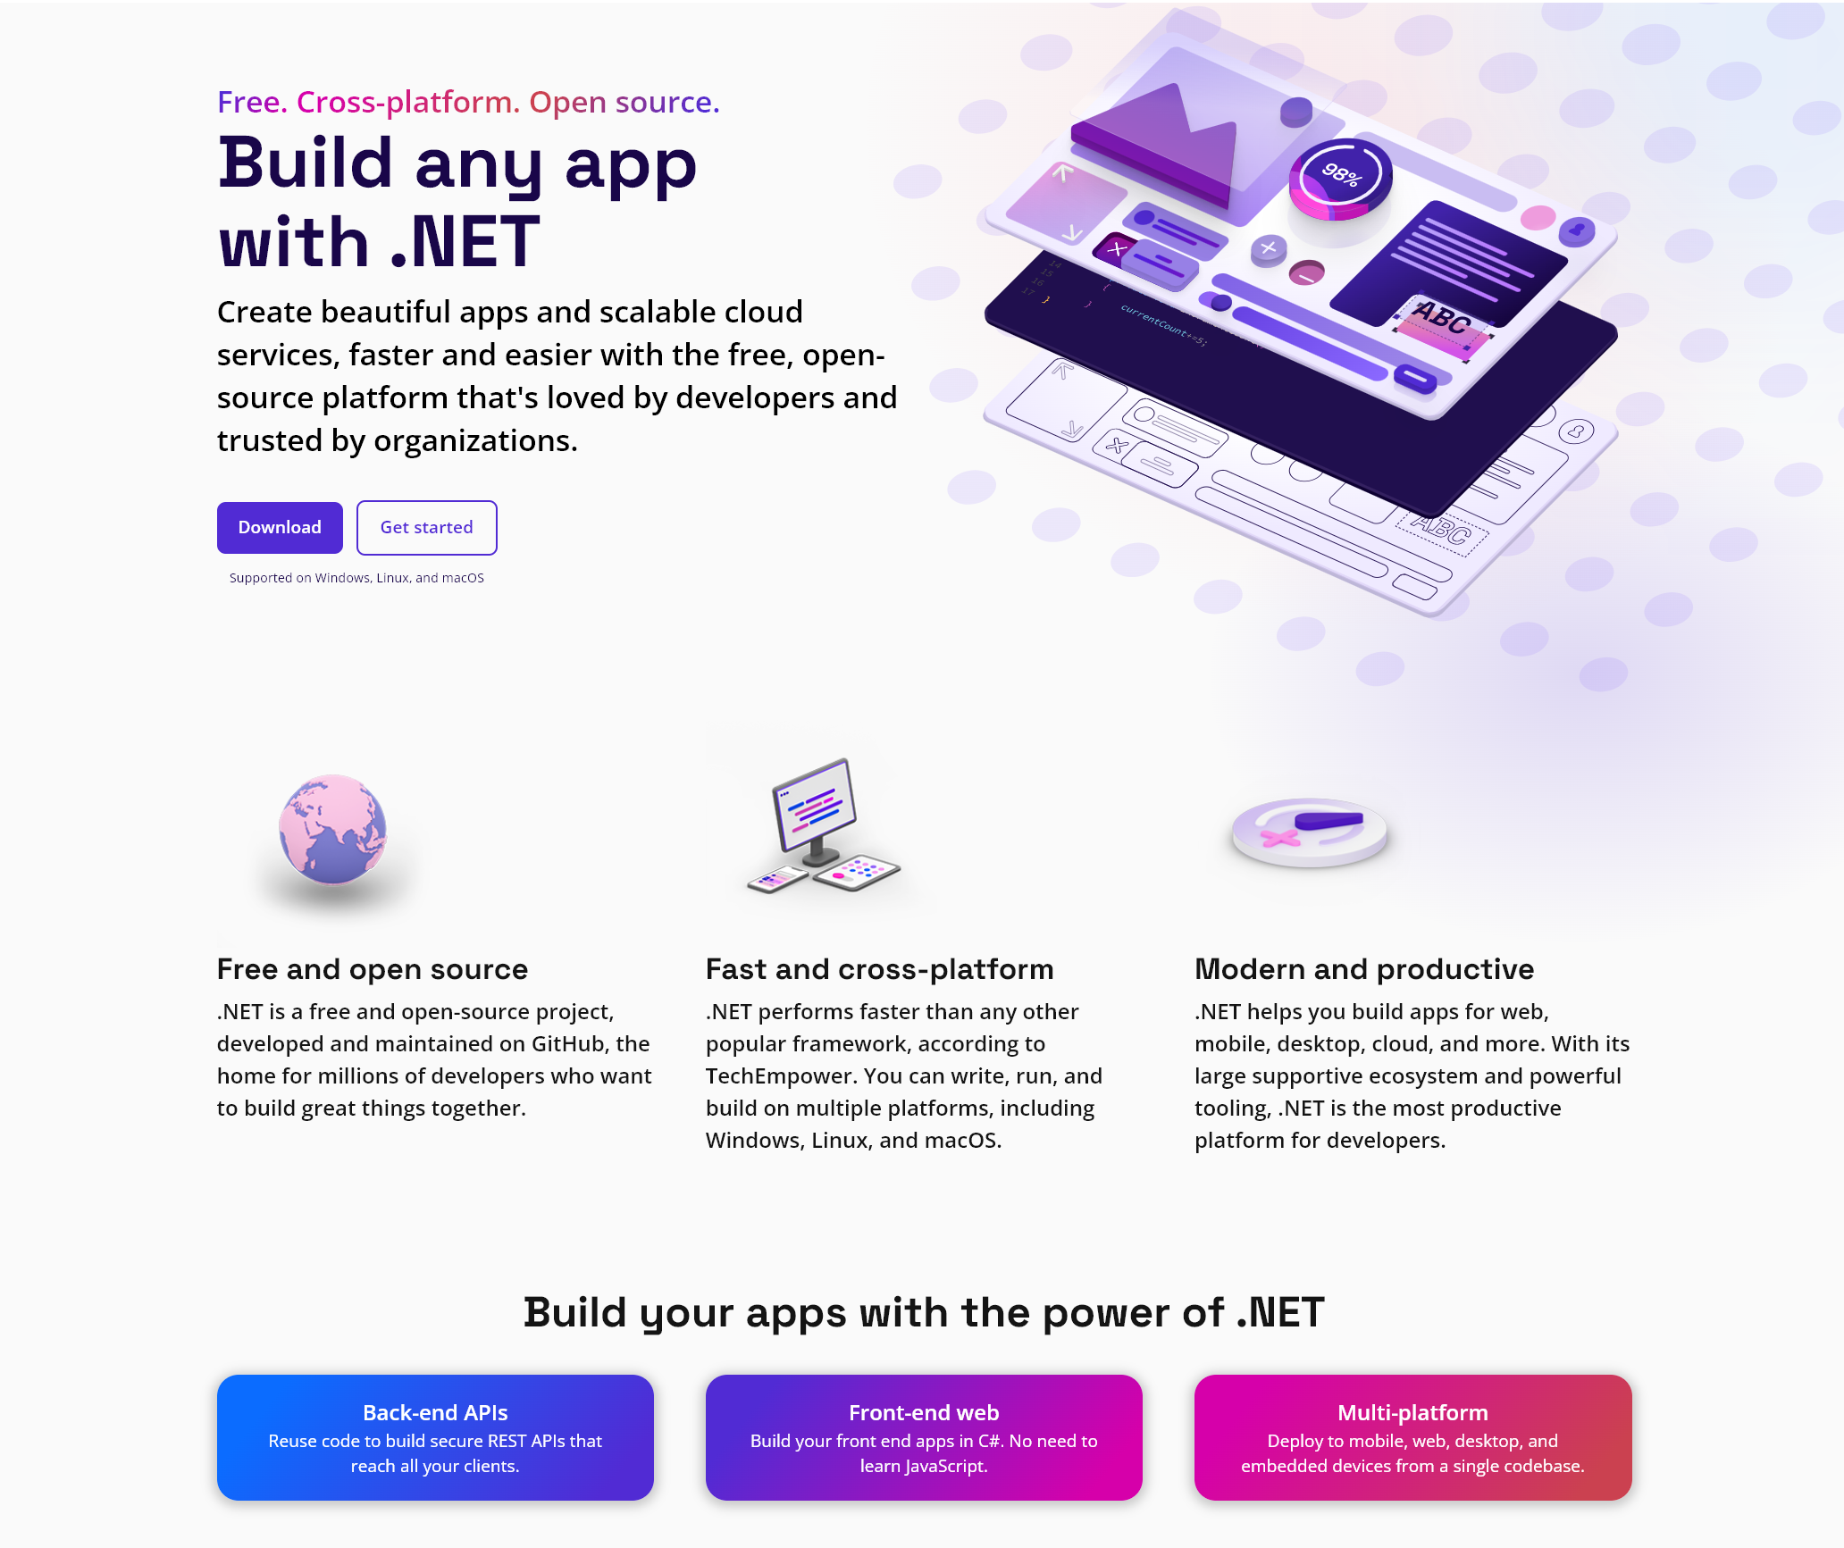
Website redesign

Slide 20


Thank you!
Let's build amazing apps with .NET 7 get.dot.net/7
Notes:
Let me close this morning by thanking each and every one of you – whether you are already building on .NET or are just thinking of getting started.
You can go to get.dot.net/7 to download .NET 7 today and start building amazing application.
Thank you so much for joining us and have a great .NET Conf!

